Slide 1
Mobile Application Development
Activity Life cycle

Slide 2
Life cycle of an Android application.
Internally, each user interface screen is represented by an Activity class.
Each activity has its own life cycle
A life cycle of an activity is the steps that an activity goes through from start state to exit state .
An application is one or more activities plus a Linux process to contain them.
In Android, an application can be “alive” even if its process has been killed.
This is because the activity life cycle is not tied to the process life cycle.
Processes are disposable containers for activities.

Slide 3
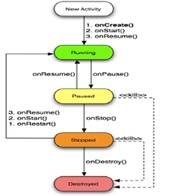
life cycle of an Android application.
The following figure states of an activity during life cycle.

Slide 4
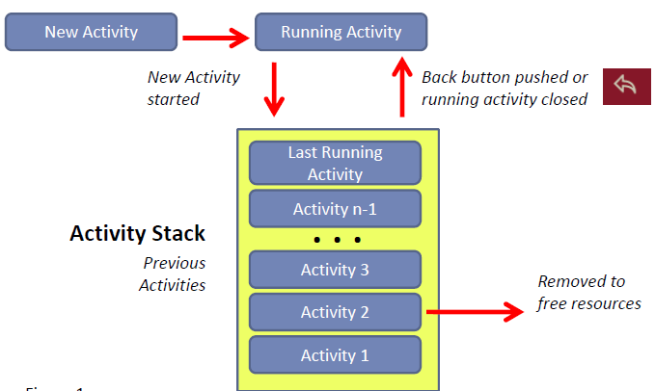
Activities states
During its lifetime, each activity of an Android program can be in one of the following states.
New Activity state: is a new activity that is being to loaded to memory (i.e. allocated memory).
2. Active or running state is in the foreground of the screen (at the top of the activity stack for the current task).
This is the activity that is the focus for the user's actions.

Slide 5
Activities states
3. Paused activity has lost focus but is visible to the user.
That is, another activity lies on top of it and that new activity either is transparent or doesn't cover the full screen.
A paused activity is completely alive (it maintains all state and member information and remains attached to the window manager), but can be killed by the system in extreme low memory situations.

Slide 6
Activities states
4. Stopped activity is completely obscured by another activity.
It still retains all state and member information.
However, it is no longer visible to the user so its window is hidden and it will often be killed by the system when memory is needed elsewhere.
5. Destroyed activity is killed (i.e. dropped) activity to reclaim memory. Activity that is no longer in the activity stack

Slide 7
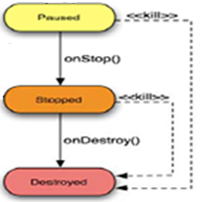
Killable States
Killable States are states that are followed by activity termination (destroyed state).
They include paused state and stopped state.

Slide 8
Activity Lifecycle
There are seven transition methods define the entire lifecycle of an activity.
The entire lifetime of an activity happens between the first call to onCreate() through to a single final call to onDestroy().
An activity does all its initial setup of "global" state in onCreate(), and releases all remaining resources in onDestroy().
Activity methods need to be overriden in the activity class so that Android can call them at the appropriate time:

Slide 9
Activity life cycle methods
1. Oncreate() method
It is the first method to be called when activity is first created (first starts up)
An activity does all its initial setup of "global" state in onCreate().
It can be used to perform one-time initialization such as creating the user interface.
This is where normal static set up is done e.g create views, bind data to lists, and so on.
All activities must implement onCreate( ) method to do the initial setup when the object is first instantiated.
This method is passed a Bundle object containing the activity's previous state, if that state was captured. i.e. onCreate(Bundle)
Oncreate() is always followed by onStart()

Slide 10
Activity life cycle methods
2. onStart() Method
This method is called just before the activity becomes visible to the user or displayed to the user.
The method is executed when the activity start running.
It is followed by onResume() if the activity comes to the foreground, or onStop() if it becomes hidden.
3. onResume() Method:
This method is called when an activity result or a new intent is delivered.
At this point the activity is at the top of the activity stack, with user input going to it.
It is a good place to start animations and music.
This method is always followed by onPause().

Slide 11
Activity life cycle methods
4. onPause() Method:
This method is called when the device goes to sleep or when a new activity is started.
It runs when the activity is about to go into the background, usually because another activity has been launched in front of it.
The method is typically used to commit unsaved changes to
persistent data, stop animations and other things that may be
consuming CPU.
onPause() Method is followed either by onResume() if the activity returns back to the front, or by onStop() if it becomes invisible to the user.
The activity in this state is killable (destroyable) by the system

Slide 12
Activity life cycle methods
5. onStop() method:
This method is called when the activity is no longer visible to the user and it won’t be needed for a while.
This may happen because it is being destroyed, or because
another activity (either an existing one or a new one) has been resumed and is covering it.
The method is followed either by onRestart() if the activity is coming back to interact with the user, or by onDestroy() if this activity is going away.
The activity in this state is killable (Destroyable) by the system.
If memory is tight, onStop( ) may never be called (the system may simply terminate the current process).

Slide 13
Activity life cycle methods
6. onRestart() Method:
This method is called after the activity has been stopped, just before being started again.
If this method is called, it indicates that the activity is being redisplayed to the user from a stopped state
onRestart() method is always followed by onStart()

Slide 14
Activity life cycle methods
7. onDestroy() Method:
This method is called just before the activity is destroyed (killed).
It is the final call that the activity will receive.
It could be called either because the activity is finishing or because the system is temporarily destroying this instance of the activity to save space.
The activity in this state is killable (Destroyable) by the system.
If memory is tight, onDestroy( ) may never be called (the system may simply terminate your process).

Slide 15
Other activity methods
onSaveInstanceState(Bundle):
This method is called to allow the activity to save per-instance state, such as a cursor position within a text field.
Usually you won’t need to override it because the default implementation saves the state for all your user interface controls automatically.
onRestoreInstanceState(Bundle):
This is called when the activity is being reinitialized from a state previously saved by the onSave-InstanceState( ) method.
The default implementation restores the state of your user interface.

Slide 16
Visible Lifetime
The visible lifetime of an activity happens between a call to onStart() until a corresponding call to onStop().
During this time, the user can see the activity on screen, though it may not be in the foreground and interacting with the user.
The onStart() and onStop() methods can be called multiple times, as the activity alternates between being visible and hidden to the user.
Between these two methods, you can maintain resources that are needed to show the activity to the user.

Slide 17
Foreground Lifetime
The foreground lifetime of an activity happens between a call to onResume() until a corresponding call to onPause().
During this time, the activity is in front of all other activities on screen and is interacting with the user.
An activity can frequently transition between the resumed and paused states

Slide 18
Compiling Android applications
Compiling android application is the process of converting java
source code into executable code.
It consists of the following steps:
Java compiler: converts java source code to java byte code (class files).
2. Dalvik executable translator (dx) converts java byte code to dalvik executable (.dex) file
3.Android Application package tool(aapk) bundles dalvik executable into an archive called android package kit (.apk) file

Slide 19





